Slide 1

B. Tech. Project AY 2024-25
Final Presentation
ProjectID: 7
Title of the Project: AI DRIVEN BOX CREATION WITH BUDGET AND PREFERENCE
Name of the Guide: Dr. Shivali Wagle
Group Members:
Snehin Gopakumar Nair (21070126091)
Subham Gaggar (21070126094)
Sumeet Saini (21070126095)
Surya Kant Pandidhar (21070126096)
19-09-2024
Department of Artificial Intelligence & Machine Learning

Slide 2
Outline of the Presentation
Introduction
Problem Statement
Objectives
Workflow
Algorithms Applied
Project Outcome
Results
Conclusion
19-09-2024
Department of Artificial Intelligence & Machine Learning

Slide 3
Introduction
The project focuses on developing a reinforcement learning-based recommendation system for creating personalized gift hampers. Users provide inputs such as budget, preferred category (biscuits, chocolates, or sweets), and expiry date constraints. The system recommends an optimized hamper based on these preferences while adhering to financial and consumption constraints. It incorporates a dynamic feedback loop, allowing users to replace disliked items with alternatives. This feedback not only customizes the current recommendation but also helps the system refine its policy for future suggestions, improving personalization over time. The project demonstrates the capabilities of AI-driven personalization, offering an adaptive and user-centric solution that evolves with each interaction, ensuring enhanced user satisfaction and smarter recommendations.
19-09-2024
Department of Artificial Intelligence & Machine Learning

Slide 4
Problem Statement
Problem:
Traditional recommendation systems fail to adapt to dynamic user preferences, budget constraints, and expiry requirements, missing finer details like disliked items and evolving feedback.
Solution:
A Reinforcement Learning-based Recommendation System for gift hampers that:
• Inputs: User-defined budget, item category (biscuits, chocolates, sweets), and expiry date.
• Dynamic Feedback Loop: Replaces disliked items and refines recommendations based on user feedback.
• Continuous Learning: Updates policies in real-time for better personalization and long-term satisfaction.
Core Challenges:
Personalization under Constraints: Budget, category, and expiry requirements.
Feedback Integration: Dynamic updates to recommendations based on user inputs.
Optimizing Satisfaction: Iteratively improves suggestions to meet evolving preferences.
Impact:
An adaptive, user-centric system that evolves with interactions, creating optimal, personalized, and cost-effective gift hampers.

Slide 5
Objectives
To develop an intelligent, user-centric recommendation system leveraging Reinforcement Learning (RL) for dynamic and personalized gift hampers that evolve with user feedback.
Key Goals:
1. User-Specific Recommendations:
• Budget: Suggest affordable, value-oriented hampers.
• Category: Align with user preferences (e.g., biscuits, chocolates, sweets).
• Expiry Date: Recommend items with suitable shelf life.
2. Feedback-Driven Process:
• Replace disliked items while maintaining constraints (budget, category, expiry).
• Continuously refine recommendations based on user preferences.
3. Reinforcement Learning Integration:
• Adapt recommendations through real-time policy updates.
• Learn from feedback to improve accuracy and personalization over time.
4. Long-Term User Satisfaction:
• Optimize recommendations iteratively to align with evolving user preferences.
5. Scalable & Efficient Engine:
• Handle multiple categories, budgets, and constraints with speed and precision.

Slide 6
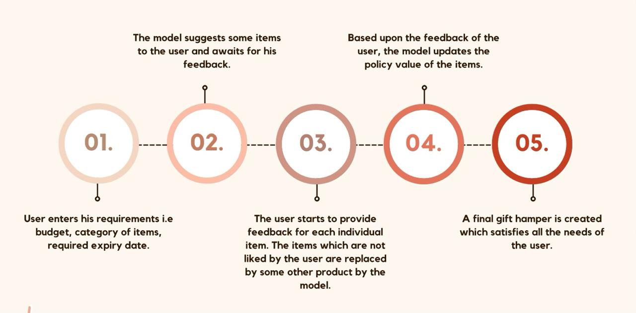
Workflow

Slide 7
Hamper Generation
The module accepts user inputs (budget, category, expiry days) and filters items from a dataset.
Items are sorted according to the policy score stored into a JSON file and then a hamper of selected items is generated under the budget constraint.
Algorithm: Generate Hamper
Input: budget, selected_categories, expiry_days, policy_data
Output: hamper (list of items)
1. Filter items by selected_categories and expiry_days.
2. For each item:
- Calculate item score from policy_data.
3. Sort items by score in descending order.
4. Initialize total_cost = 0, hamper = []
5. For each item in sorted items:
- If total_cost + item.price <= budget:
- Add item to hamper.
- Update total_cost += item.price
6. Return hamper

Slide 8
Policy Manager
• It performs policy data by loading, updating, and saving item-specific scores into a JSON file.
• Item scores are modified based on feedback, increasing for liked items and decreasing for disliked ones.
Algorithm: Update Policy
Input: item_id, feedback, policy_data
Output: updated policy_data
1. Load policy_data from JSON file.
2. If feedback is 'liked':
- Increase item’s score by increment value.
3. If feedback is 'disliked':
- Decrease item’s score by decrement value.
4. Save updated policy_data to JSON.
5. Return updated policy_data

Slide 9
Feedback Processor
• In this model, it captures and processes user feedback. Also, disliked items are given alternatives using the existing item list and policy.
• The processor also calls the PolicyManager to update the JSON policy based on feedback.
Algorithm: Process Feedback
Input: hamper, feedback_list, policy_data
Output: updated_hamper
1. For each item in hamper:
- If feedback is 'disliked':
- Call Update Policy(item_id, 'disliked', policy_data)
- Replace item with the next highest scored item within category and budget.
2. For each liked item:
- Call Update Policy(item_id, 'liked', policy_data)
3. Return updated_hamper

Slide 10
User Interface
• A simple CLI or graphical interface will accept inputs for budget, category, and expiry days from the user and then let the hamper be generated; afterwards, it accepts feedback from the user.
Algorithm: Collect User Input
Input: None
Output: user_inputs (budget, category, expiry_days)
1. Prompt user to enter budget.
2. Prompt user to select categories.
3. Prompt user to specify expiry days.
4. Return user_inputs (budget, category, expiry_days)

Slide 11
Project Outcome
Develop a personalized, feedback-driven recommendation system using Reinforcement Learning (RL) to create gift hampers based on user-defined inputs and preferences.
1. Personalized Hamper Generation
• Generated hampers meet budget and expiry requirements.
• Balanced quality, relevance, and cost with an efficient recommendation policy.
2. Dynamic Feedback-Driven System
• Feedback incorporated into the recommendation policy for improved future selections.
• Replacement functionality ensures disliked items are replaced iteratively.
3. Policy Update & Continuous Learning
• Implemented a JSON-based policy storage and update system.
• Achieved dynamic learning, ensuring hampers align with evolving user preferences.

Slide 12

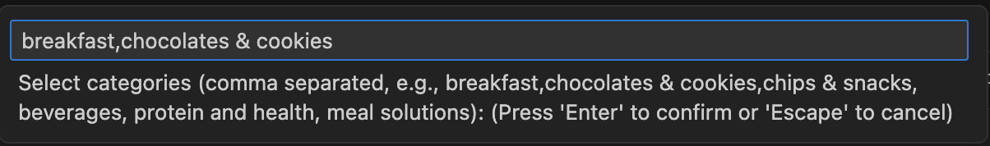
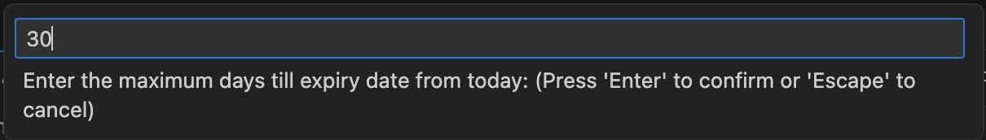
Results

Slide 13
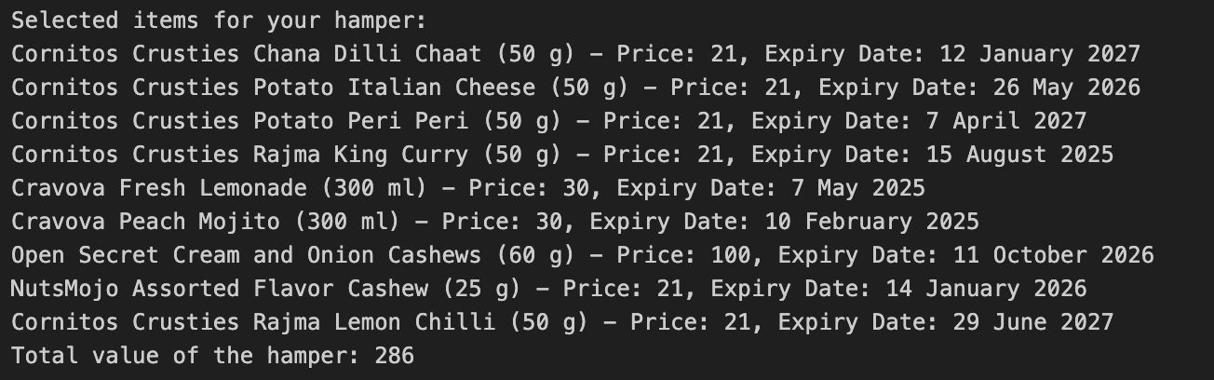
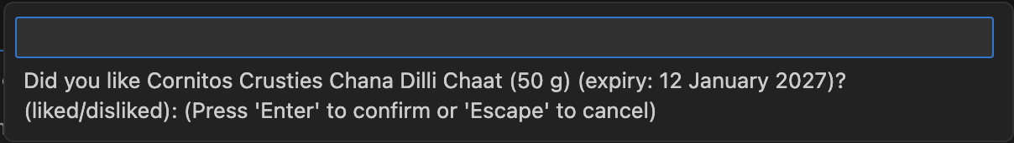

Slide 14
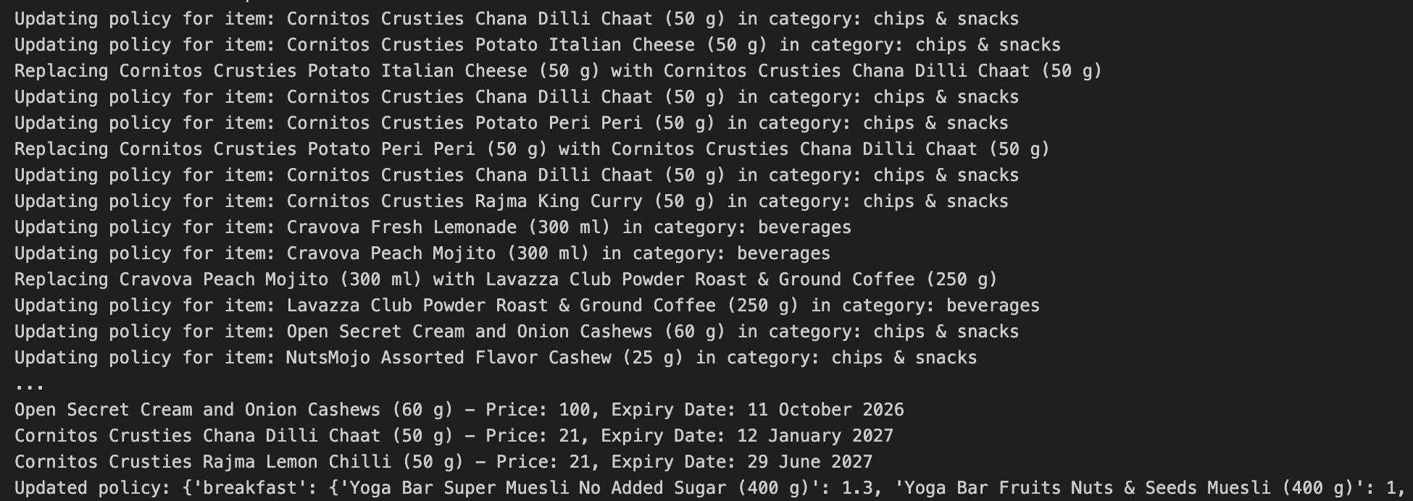

Slide 15
Conclusion
The gift hamper recommendation system, built within this project using reinforcement learning, achieved significant milestones toward personalizing the process of creating gift hampers.
Designed keeping in mind budget, category preferences, and item expiration preferences, it has been one of the representation potential of reinforcement learning in the dynamic recommendation systems. As the model integrates a feedback system with the opportunity to have real-time input given by the users over each recommended item, the system gradually learns to make its recommendations fit the user-centric and adaptive hold.
The two major successes of this project are the explanations on the applicability of RL toward improving user satisfaction for a gift hamper selection system. The task traditionally practiced is based on either manual operations or algorithms that fail to recognize changing user preferences. Our system applies RL on a policy feeding on the feedbacks from the user's likes and dislikes.
The policy is maintained and updated in a JSON file, which makes the system self-contained, lightweight, and portable. With a learning rate, it lets the model balance positive and negative feedback; as such, it may adjust its selections of items to show both short-term and long-term preferences by the users.
With a local user interface, the system enables the user to interact with the user and to collect feedback from this user, without any dependency on server or cloud infrastructure. It makes the local interface only the truly stand-alone experience which is more accessible and also more secure without dependency on network connectivity-this would help make it more usable in places where cloud solutions may not be possible or necessary.

